Slide 1
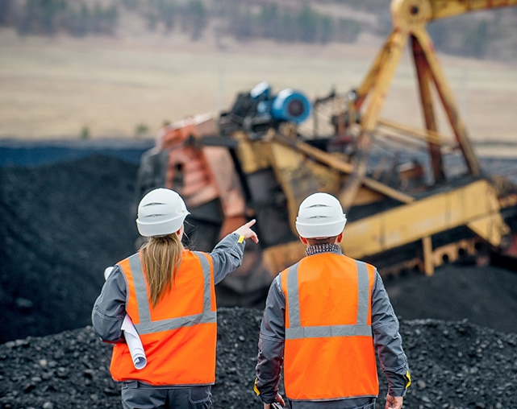
Simulation of Mining Operations using SimPy
Created By Tushar Pant
Sr. Data Scientist
An Overview of SimPy Simulation Model for Mining Operations

Slide 2
Introduction to SimPy
SimPy is a discrete-event simulation library for Python that allows modeling and simulation of complex systems.
SimPy is a discrete-event simulation library for Python.
It allows modeling and simulation of complex systems by representing processes, resources, and events.
SimPy supports both process-oriented and event-oriented simulation paradigms.
It provides a simple and intuitive API for defining simulation models and running simulations.
SimPy offers various built-in components such as resources, processes, events, and monitors for collecting simulation data.
It supports random number generation for stochastic modeling and simulation.

Slide 3
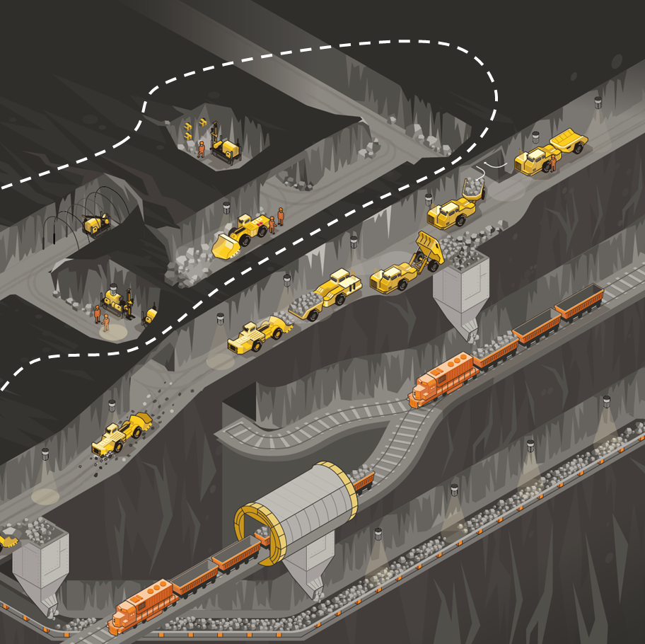
Simulation Scenario
Simulating a mining operation with resource extraction, equipment failures, and transportation logistics.
To model resource depletion, equipment failures, and transportation logistics to optimize mining operations.

Slide 4
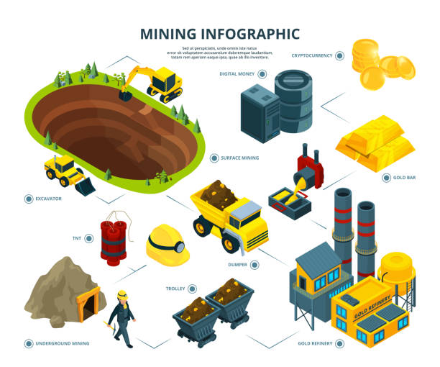
Simulation Components
Resources: Representing mining equipment, trucks, and other resources.
Processes: Modeling mining activities, equipment failures, and transportation logistics.
Events: Triggering resource depletion, equipment failures, and transportation events.

Slide 5
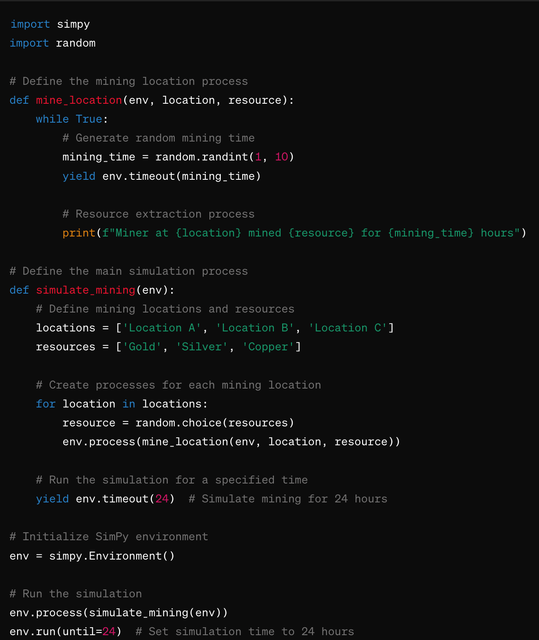
Code Overview
To simulate mining locations using SimPy, I created a discrete-event simulation where miners arrive at different locations to extract resources.
mine_location function defines the process for mining at a specific location. Miners arrive at the location, mine a random amount of resources for a random duration, and then repeat the process.
simulate_mining function sets up the simulation environment, creates processes for each mining location, and runs the simulation for 24 hours.
SimPy's Environment class is used to manage the simulation environment, and timeout is used to simulate the passage of time.
The simulation output prints the mining activity at each location, including the resource mined and the duration of mining.

Slide 6
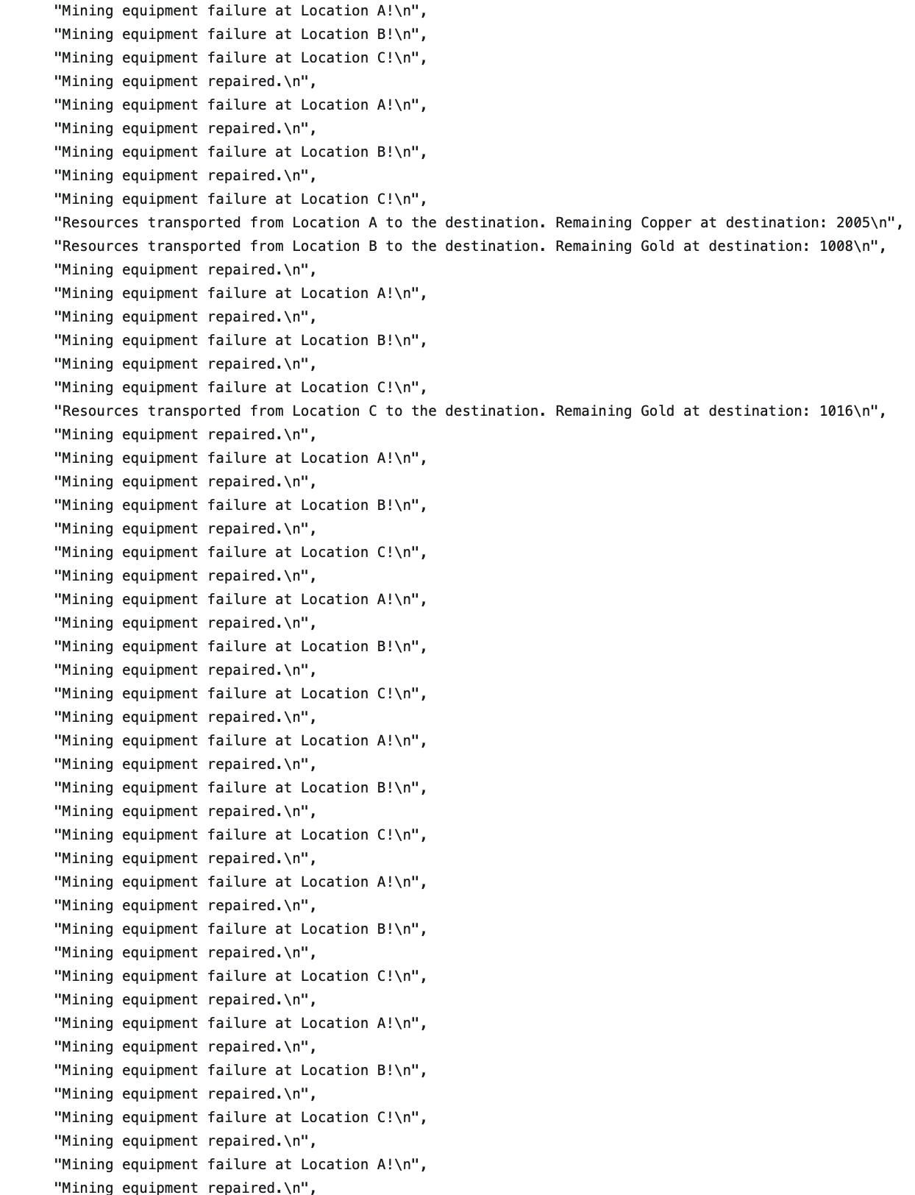
Results and Analysis
Imports:
The code imports necessary libraries, including SimPy for simulation and NumPy for numerical computations.
Parameters:
Parameters such as NUM_MINERS, SIM_TIME, INTER_ARRIVAL_TIME, NUM_RESOURCES, and RESOURCE_CAPACITY are defined to configure the simulation environment.
These parameters control the number of miners, simulation duration, inter-arrival time of miners, number of resources (ore deposits), and capacity of each resource.
Miner Process:
The miner process function defines the behavior of each miner.
Miners arrive at the mining site with a certain inter-arrival time (INTER_ARRIVAL_TIME).
Upon arrival, miners request resources for mining and yield to the environment if resources are not available.
Once resources are available, miners begin mining by consuming resources for a random duration.
Resource Depletion:
Resources are represented as shared resources with a limited capacity (NUM_RESOURCES, RESOURCE_CAPACITY).
Miners acquire resources for mining and release them once mining is complete.
Resources get depleted as miners consume them, and miners yield if resources are not available.
Simulation Environment:
The simulation environment is initialized with the desired parameters.
Miners are generated as processes with inter-arrival times following an exponential distribution.
The simulation is run for a specified duration (SIM_TIME).
Simulation Output:
During the simulation, information about miner arrivals, mining activities, and resource usage is printed.
The total amount of resources mined is calculated and printed at the end of the simulation.

Slide 7
Possible Feature Development:
To visualize the output of the simulation, we can use matplotlib, a popular Python library for creating static, animated, and interactive visualizations. We can create line plots to show the resource levels over time at each mining location.
Overall, this SimPy code provides a basic simulation of a mining operation where miners arrive, consume resources for mining, and yield if resources are unavailable. It demonstrates the use of modeling complex systems with discrete-event simulation techniques.

Slide 8

Q&A

